Slide 1

Bank Loan Case Study
Name : Muskan Pritam
Notes:
Good morning trainity team, im here infront of u all to put up a presentation about the project that I made named bank loan case study. Im muskan Pritam, and lets dive into it.

Slide 2

INTRODUCTION
Risks in Loan Approval:
Lost Business: Rejecting capable applicants.
Financial Loss: Approving applicants who are defaultars.
Possible Outcomes for Loan Applications:
Approved: Loan application approved.
Cancelled: Customer cancelled application.
Refused: Company rejected the loan.
Unused Offer: Loan approved but not used by the customer.

Slide 3
INTRODUCTION
Goal of the Project:
Use Exploratory Data Analysis (EDA) to:
Understand customer and loan attributes.
Identify patterns indicating loan default risk.
Business Objectives:
Identify Patterns:
Make Informed Decisions: Deny risky loans, Adjust loan amounts, Adjust interest rates for risky applicants.

Slide 4

LET’S START
WITH THE TASKS GIVEN TO US

Slide 5
TASK 1:
Identify Missing Data and Deal with it Appropriately: As a data analyst, you come across missing data in the loan application dataset. It is essential to handle missing data effectively to ensure the accuracy of the analysis.
Task: Identify the missing data in the dataset and decide on an appropriate method to deal with it using Excel built-in functions and features.

Slide 6
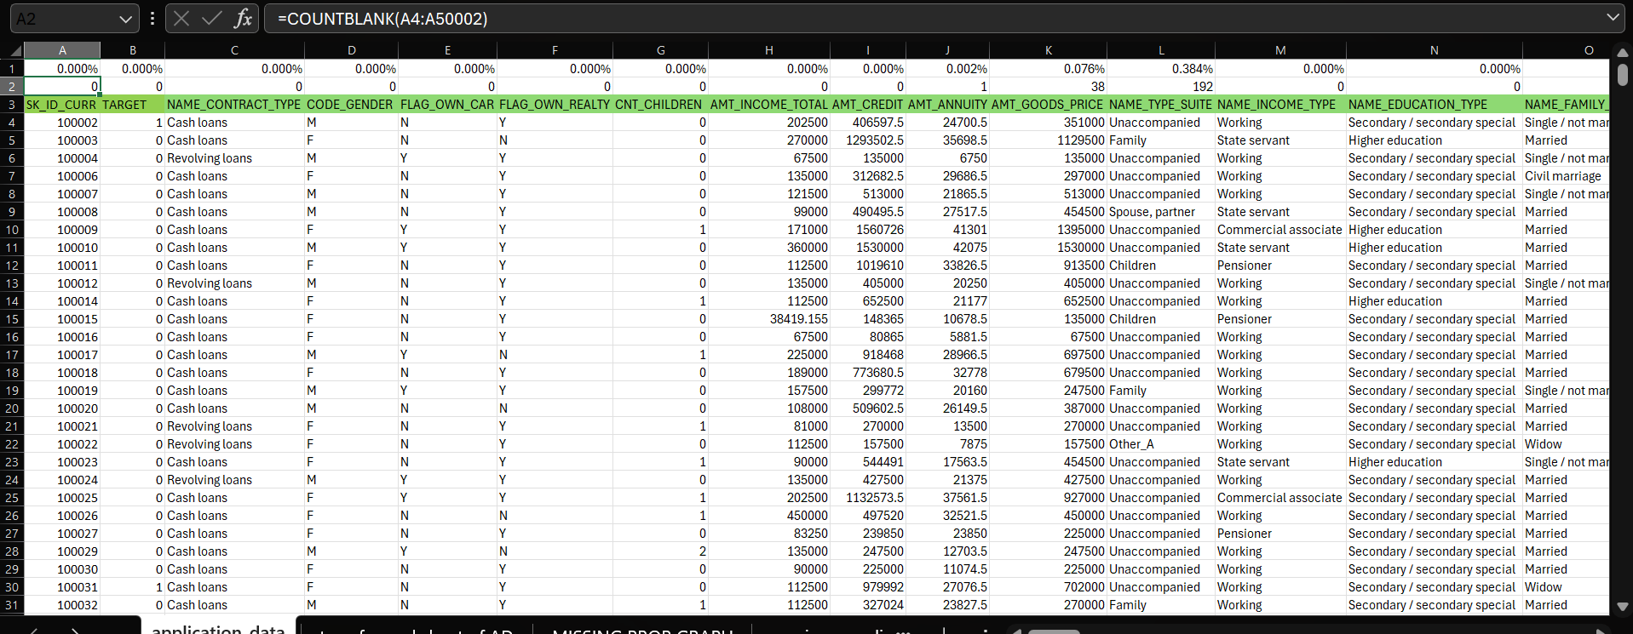
In this task we need to Identify the missing data And use the appropriate methods and functions we need to use in order to deal with the bulky amount of data given to us in excel sheet. As we can see below it's the original data given to us by the Trainity so I added the first 2 rows one with the proportion of blank cells in a particular column and row 2 with the count of blank cells with range using the function ‘countblank’ .
The formulas used here are:
1. =COUNTBLANK(A4:A50002) : this function indicates to find the number of blank cells for the column A with range A4:A50002.
2. =A2/49999 : This function indicates how to find the blank proportion of that column which is having a total number of 49999 number of cells.

Slide 7
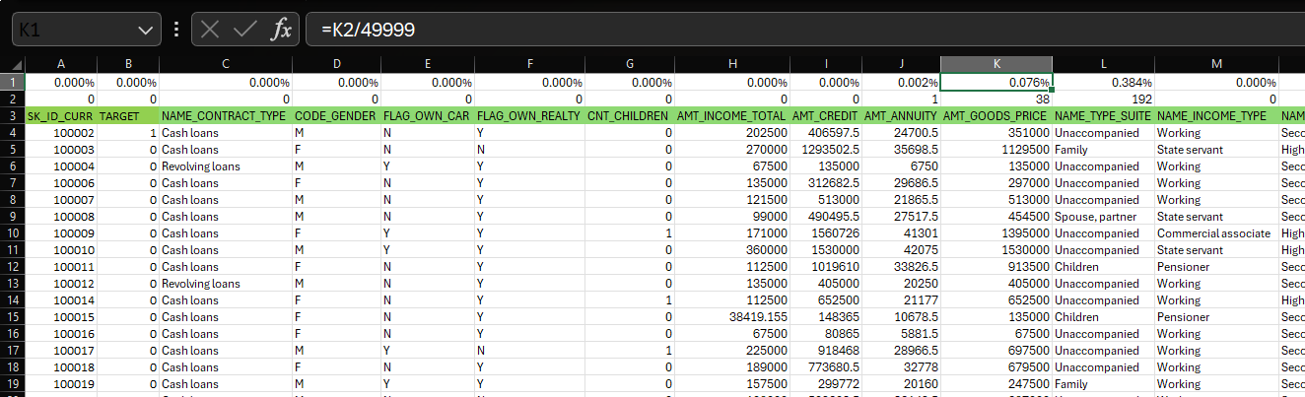
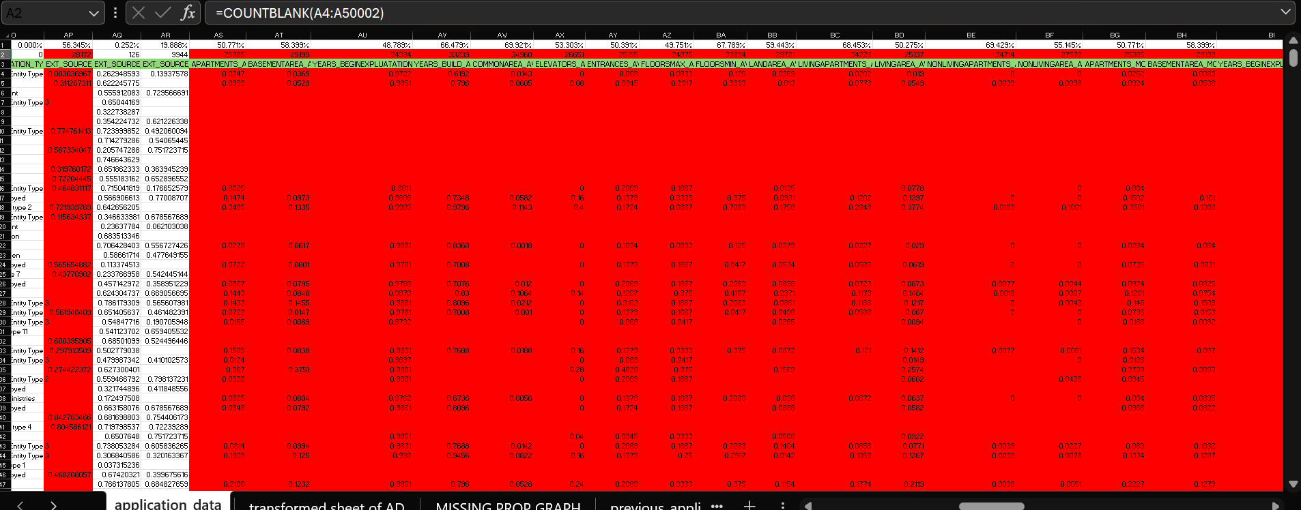
Here in this screenshot we can see the other formula that we discussed in the previous slide to find the proportion of blank cells.
In this screenshot beside we can see that I marked the columns in red were there are the proportion of blank cells more than 45% as those datas are not of much use because they are almost half empty. And it won't help if we fill those blank cells with its median or average so instead we deleted those columns to make our data more appropriate to work with unless it's an important column to keep.

Slide 8
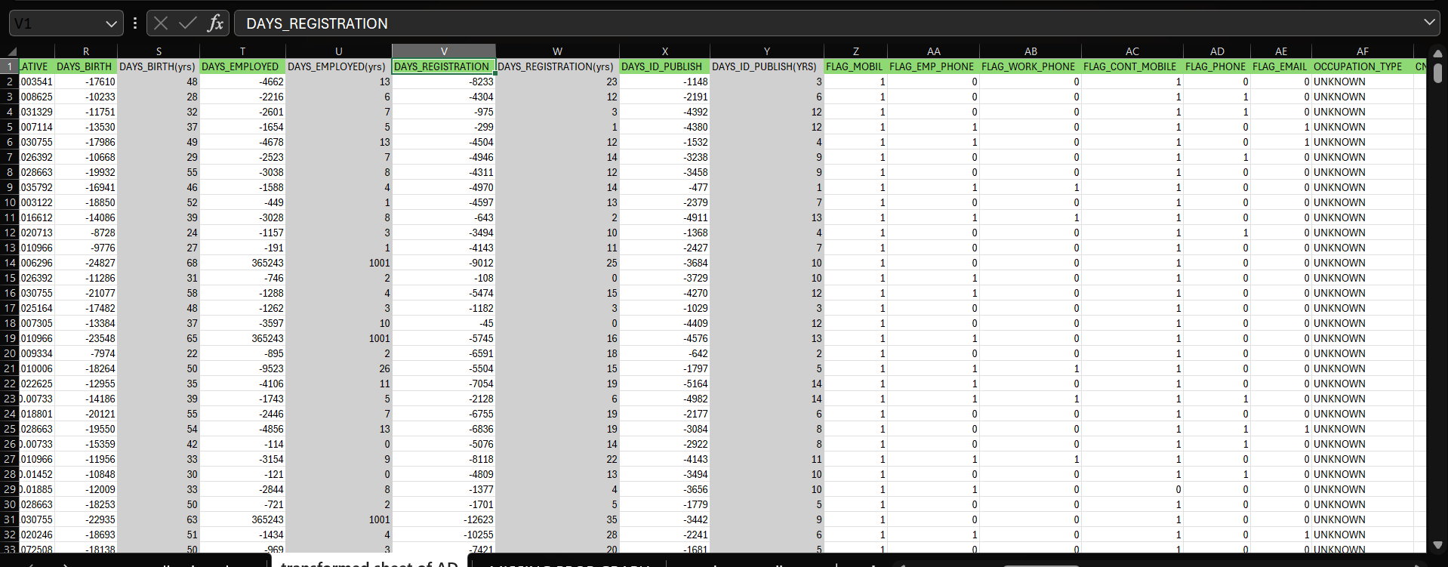
After deleting all the unrequired columns having blank proportion more than 45% , we are left with this transformed data of original application data. So as we can see there are 4 columns named days_birth ,days_employed, days_registration, days_ID_publish having number of days in negative also positive and the number of days are much high which may be inconvenient to work with so we inserted new columns beside those and used the formula given below along with absolute function to remove the negative sign and divided the days with the number of total days in a year that is 365 to get those column values into years.
=(ABS(R2/365)) : this is used to convert the days column with negative values also positive values into all positive and also to convert days to years by dividing it by the total number of days in year that is 365.

Slide 9
In a new sheet we took all the column names in one row and in second row we calculated the missing values count and the 3rd row we calculated the missing proportion using the formulas discussed before. now we inserted a table using all these columns and rows and got the chart as we can see on the left side. If we analyse this chart properly we can see that few of the columns have missing values more than the rest of columns so we need to delete few columns in order to work in a better way to get a better result without any hindrance.

Slide 10
TASK 2:
Identify Outliers in the Dataset: Outliers can significantly impact the analysis and distort the results. You need to identify outliers in the loan application dataset.
Task: Detect and identify outliers in the dataset using Excel statistical functions and features, focusing on numerical variables.

Slide 11
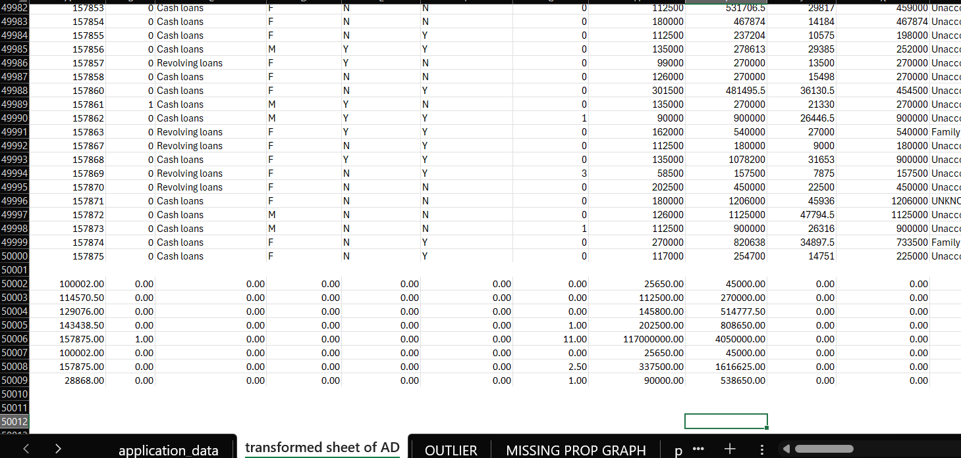
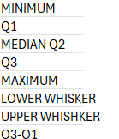
MINIMUM= MIN(A2:A50000)
Q1= IFERROR(QUARTILE.INC(A2:A50000,1),0)
Q2(MEDIAN)= IFERROR(QUARTILE.INC(A2:A50000,2),0)
Q3= IFERROR(QUARTILE.INC(A2:A50000,3),0)
MAXIMUM= IFERROR(MAX(A2:A50000),0)
IQR= A50005-A50003
LOWER WHISKER= MAX(MIN(A2:A50000),A50003-1.5*(A50005-A50003))
UPPER WHISKER= MIN(MAX(A2:A50000),A50005+1.5*(A50005-A50003))
In task we are required to find outliers in the given data after transforming it by removing the unrequired columns having blank cells more than 45%. So in order to find the outlier we need to find few values related, to make a box plot and calculate outliers in the particular column. And those values are minimum, Q1, Q2, Q3, maximum, IQR, lower whisker, upper whisker. To calculate all these we need to use the functions given on the left side of this slide. we also used iferror function to remove the #NUM! Error during the calculation.

Slide 12
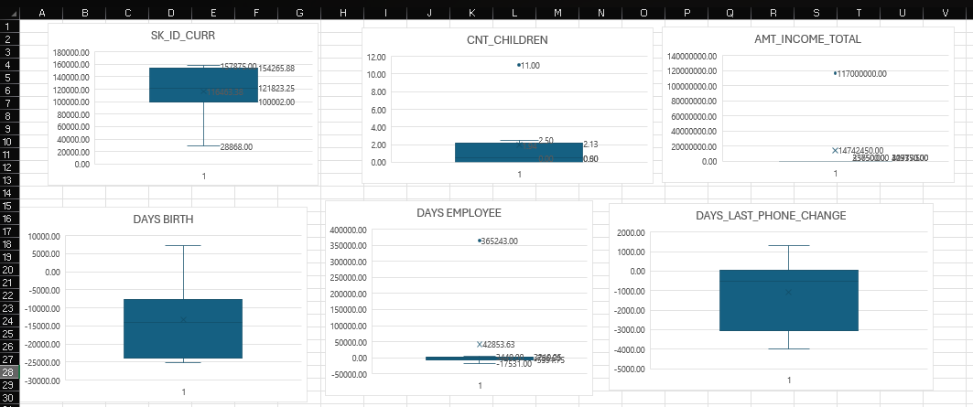
Here we can see few of the box plot charts showing that the columns have outliers and few don‘t. We can create a box plot chart by selecting the range of cells we want to use to make a box plot then by going to insert on the ribbon then in the chart section we can see there is a drop down beside a histogram icon so by clicking that we get an option of box and whiskers and after that we get a box plot for the following range we selected. Also we can do some alteration in the chart if we need. In this cnt_children graph we can see that there is an outlier having value 11 as it's much more than the required range of that cnt_children column, also in the chart beside that named amt_income_total we can see that there is also an outlier which is much higher than the expected range of that column.

Slide 13
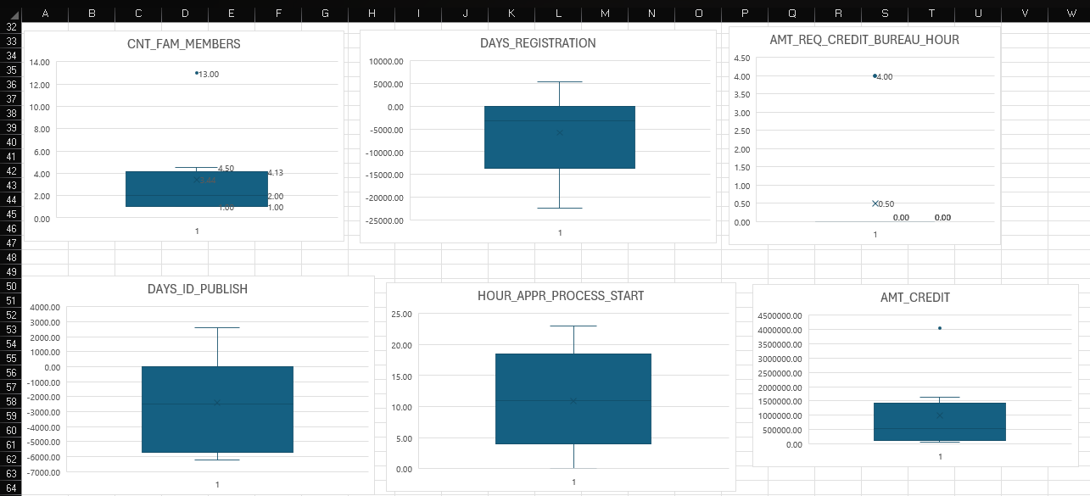
In this slide too we can see at there are few of the graphs which show the outliers namely cnt_fam_members also amt_req_credit_hour Also few more graphs. by seeing all these graphs in this slide and the slide before we can conclude that there are few of the columns in transformed data of application data given to us by the Trainity that does not fit in the required range and the can create alteration in the accuracy of the calculation that we need, so we can remove these outliers to perform a better calculation and thus work properly.

Slide 14
TASK 3:
Analyze Data Imbalance: Data imbalance can affect the accuracy of the analysis, especially for binary classification problems. Understanding the data distribution is crucial for building reliable models.
Task: Determine if there is data imbalance in the loan application dataset and calculate the ratio of data imbalance using Excel functions.

Slide 15
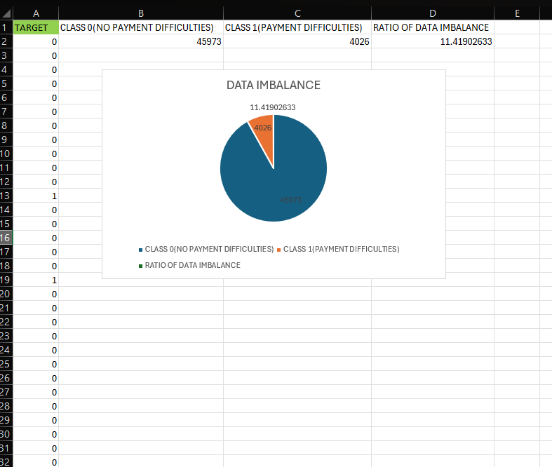
FORMULAS USED:
CLASS 0: =COUNTIF(A2:A50000,0)
CLASS 1: =COUNTIF(A2:A50000,1)
RATIO: =B2/C2
In this task Required to determine the data imbalance in the loan application data set and also calculate the ratio of data imbalance using the excel functions.
So as we can see in the screenshot beside we took the column target in a different sheet and performed calculation on it. target contains values Such as 0 and 1. 0 means that there is no payment difficulties and 1 means that there is payment difficulties. So in next column we counted the class 0, that is, people having no payment difficulties using the countif function with range and Criteria. In the next column we calculated the class 1, that is, people having payment difficulties so by using both of the classes, class 0 and class 1 we found out the ratio of data imbalance by dividing class 0 and class 1 which came out to be 11.419 , it shows that there is a little imbalance in data but not much. so by using all the 3 columns, class 0 ,class 1 and ratio we inserted a pie chart to analyse properly. In the pie chart we can see that most of the space is taken by class 0 and little angle is taken by class 1 resulting in imbalance of data.

Slide 16
TASK 4:
Perform Univariate, Segmented Univariate, and Bivariate Analysis: To gain insights into the driving factors of loan default, it is important to conduct various analyses on consumer and loan attributes.
Task: Perform univariate analysis to understand the distribution of individual variables, segmented univariate analysis to compare variable distributions for different scenarios, and bivariate analysis to explore relationships between variables and the target variable using Excel functions and features.

Slide 17
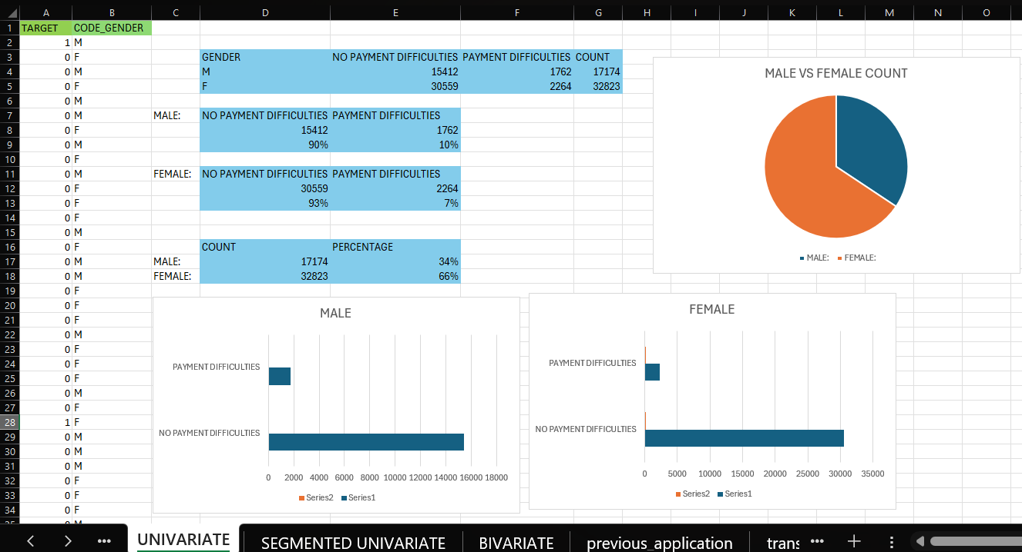
In this task we were asked to find the univariate analysis to understand the distribution of individual variables to gain insight into the driving factors of loan application. Univariate analysis focuses on examining the distribution and summary statistics of a single variable at a time.
In this we took the column target with the column code_gender and performed the calculations such as counting the number of payment difficulties for only males similarly for females too. Also we calculated for people who are not facing any payment difficulties individually for males and females.
Formulas: 1.for males and no payment difficulties: =COUNTIFS($B$2:$B$50000,"M",$A$2:$A$50000,"0")
2.Count of males: =COUNTIF($B$2:$B$50000,"M")
3. Percentage of male having no difficulties:
=(D8/(D8+E8))
Similarly we can do this for females.
We plotted the horizontal bar graph for males and females having payment difficulties and not having payment difficulties. Also Plotted a pie chart for the count of males and females and clearly we can see that there are more number of males than females.
UNIVARIATE

Slide 18
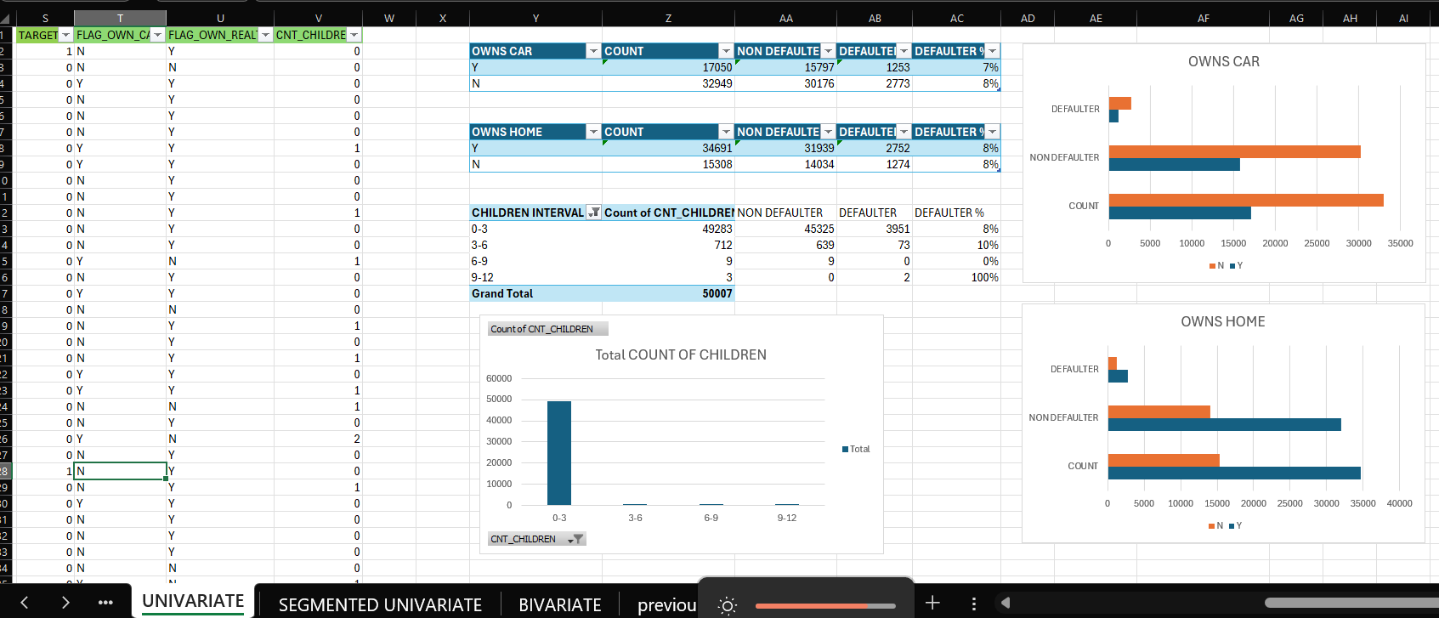
In this we took the columns flag_own_car, flag_own_realty, cnt_children along with target column. We used these columns to calculate an analysis such as in the first table we can see that we counted the number of people who owns a car also who did not. We also counted the defaulters and non defaulters and also the defaulters percentage using the formulas given below. Similarly in the next table we calculated the number of people who own a home , also someone who owns a home but also a defaulter or a non defaulter along with defaulter percentage. In the 3rd column we can see that we have the interval of children starting with the age zero to the age 12. we counted the number of children that lie between these intervals along with the people having children between these interval and also are non defaulter or defaulter also calculated the defaulter percentage. And thus using these tables we plotted the graphs and analysed how many are the defaulters and non defaulters in the table graphically.
Formulas used: 1. =COUNTIFS($T$2:$T$50000,"Y")
2. =COUNTIFS($T$2:$T$50000,"Y",$S$2:$S$50000,"0")
3. =COUNTIFS($T$2:$T$50000,"Y",$S$2:$S$50000,"1")
4. =AB3/(AB3+AA3)

Slide 19
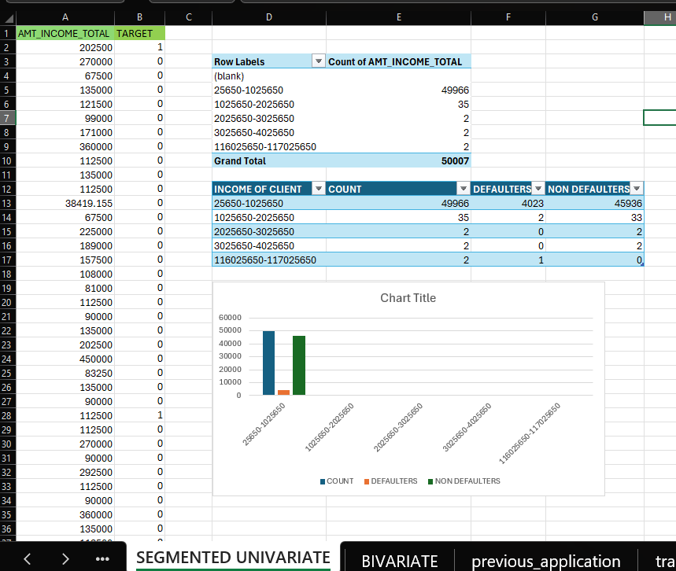
SEGMENTED UNIVARIATE
Segmented univariate is Analyzing a single variable separately within different segments or groups of another variable.
So In this we see that we have created bins for the calculation of defaulters, non defaulters along with their count. We can create the bins by selecting the range of data than creating a pivot table, now we need to drag the column name in the Row after which we need to select column according to which we need to make the bins then click on the group selection and then select the starting and ending points for the bins then click OK ,we will get the bins according to the interval we selected.
Formulas:
defaulters: =COUNTIFS($B$2:$B$50000,"1",$A$2:$A$50000,">=25650",$A$2:$A$50000,"<1025650")
Non defaulters: =COUNTIFS($B$2:$B$50000,"0",$A$2:$A$50000,">=25650",$A$2:$A$50000,"<1025650")

Slide 20
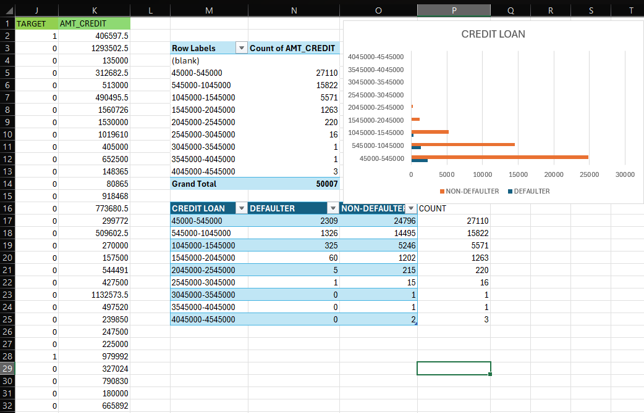
Formulas used:
defaulters: =COUNTIFS($K$2:$K$50000,">=45000",$K$2:$K$50000,"<545000",$J$2:$J$50000,"1")
Non- defaulters: =COUNTIFS($K$2:$K$50000,">=45000",$K$2:$K$50000,"<545000",$J$2:$J$50000,"0")

Slide 21
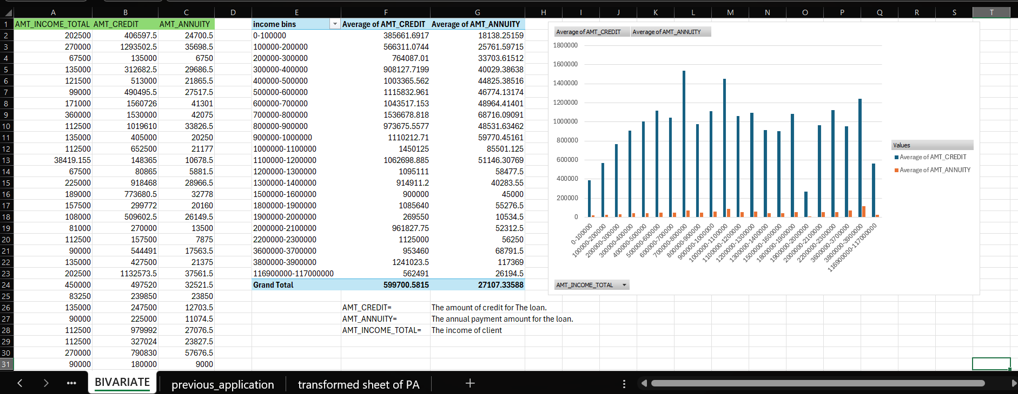

BIVARIATE
Bivariate analysis Is used to analyze the relationship between two variables to determine if and how they are related.

Slide 22
TASK 5:
Identify Top Correlations for Different Scenarios: Understanding the correlation between variables and the target variable can provide insights into strong indicators of loan default.
Task: Segment the dataset based on different scenarios (e.g., clients with payment difficulties and all other cases) and identify the top correlations for each segmented data using Excel functions.

Slide 23
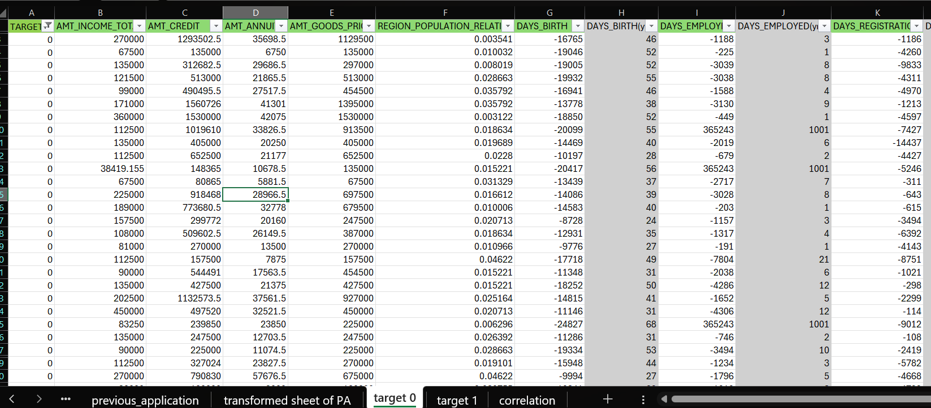
In this task we were asked to find the correlation between the tables by using the target column. So we copied all the original data from the transformed application data set and pasted in a new sheet then by using the filter and sort filtered out the target equals to zero only. Also by removed the column which were not required for the correlation function.

Slide 24
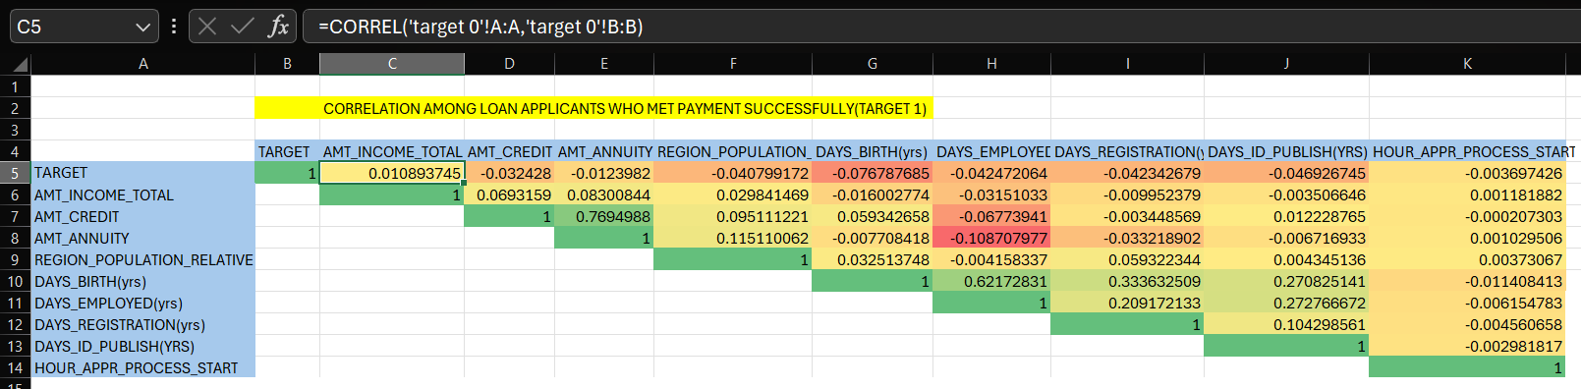
Formula: =CORREL('target 0'!A:A,'target 0'!B:B)
In a new sheet we manage to get the column names in the following format as seen above. We use the function correl with the values range for which we will need to find the correlation here. We were also asked to colour the cells differently for different correlation numbers. Here we can see the shades of green, yellow and red indicating that the green cells have the highest correlation then the yellow cells then we go to the Red cells. 1 is the highest correlation that two cells can have which means they are highly correlated with each other and the red cells we have here which shows -0.108 is the least correlated number that means these columns have no relation in between them.

Slide 25
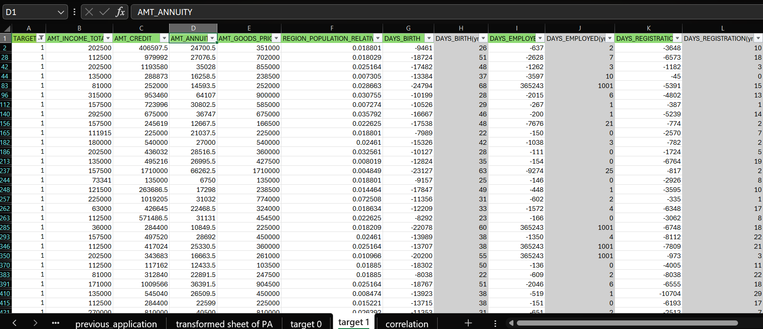
In this task we were asked to find the correlation between the tables by using the target column. So we copied all the original data from the transformed application data set and pasted in a new sheet then by using the filter and sort, we filtered out the target equals to one only. Also we removed the column which were not required for the correlation function.

Slide 26
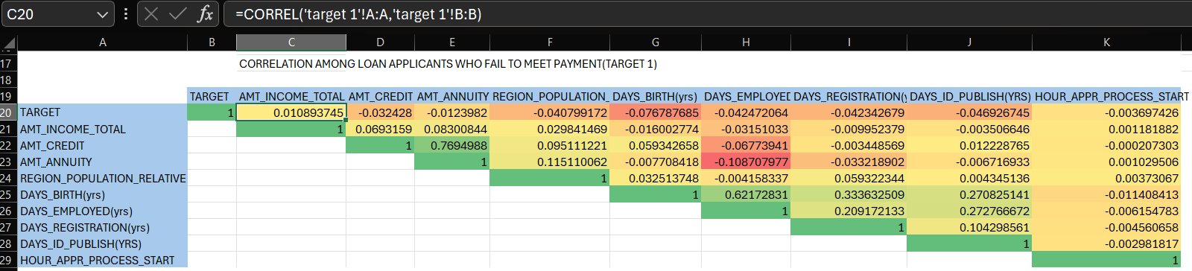
Formula used: =CORREL('target 1'!A:A,'target 1'!B:B)
In a new sheet we manage to get the column names in the following format as seen above. We use the function correl with the values range for which we will need to find the correlation here. We were also asked to colour the cells differently for different correlation numbers. Here we can see the shades of green, yellow and red indicating that the green cells have the highest correlation then the yellow cells then we go to the Red cells. 1 is the highest correlation that two cells can have which means they are highly correlated with each other and the red cells we have here which shows -0.108 is the least correlated number that means these columns have no relation in between them.

Slide 27


THANK YOU ALL
Notes:
So at last, I would like to thank you all for the patience hearing.

